Slide 1
Lab 2: Session 2 - Factor of Safety
ASEN 2001
Fall 2018

Slide 2
Announcements
By next lab:
complete 3D conversion of truss code
modify code to account of truss’ self-weight
(for head start on following weeks tasks: detailed designs and Monte Carlo simulation)
2D MATLAB Monte Carlo simulation code truss2dmcs.m posted on Canvas
Guidelines on computing Factor of Safety posted on Canvas
Very helpful!

Slide 3
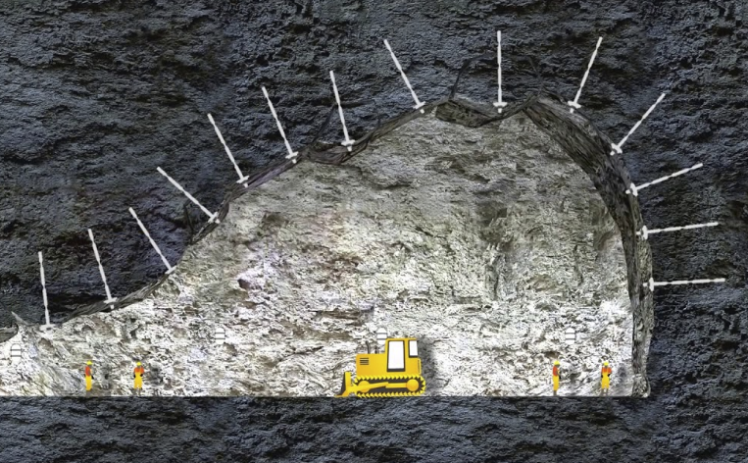

Why is factor of safety important?
Photo courtesy: Department of Mines of Western Australia and D-Bolt

Slide 4
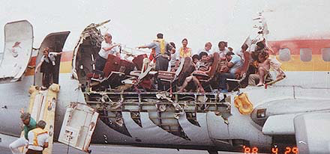
Selecting factor of safety
Some considerations:
accuracy of predicted loads
variation in strength of material
environmental effects
cost of over-engineering components
consequences of failure
Aerospace FOS typ. 1.3-2
See ‘Factor of Safety.docx’
Aloha Airlines Flight 243 Fuselage blew open in flight due to material fatigue effect as a result of corrosion (1988). [the.honoluluadvertiser.com]

Slide 5
Steps involved
Failure:
bar
magnet
joint
geometry, loading, …
“material”
Step 1: Assuming a failure probability, identify FOS and F_{design} for a bar
Quantifiable FOS instead of just ‘picking’ a number
Step 2: Design the truss so that the bar forces do not exceed F_{design}
Step 3: Perform Monte Carlo simulation to estimate failure probability of truss under as-built deviations from design; refine failure probability of bars if needed

Slide 6
Step 1 – From failure probability to FOS
Notes:
Fmax = max force in the truss, which can vary randomly because of variations in the truss construction or the material the truss is made from.
Fdesign = is the force you want to limit the force in the truss to.

Slide 7
Step 1 – From failure probability to FOS
area =
Pick a failure probability and find F_{design} :
MATLAB:

Slide 8
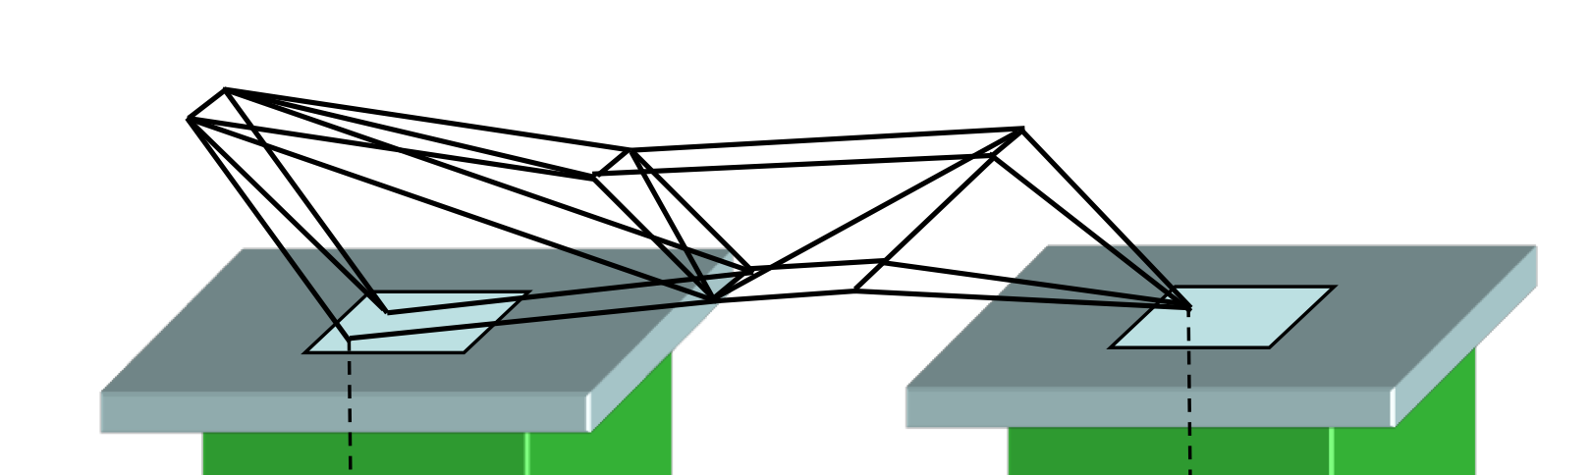

Step 2 – Truss design
Design your truss such that:
: maximum bar force magnitude
$$F_{max}=N(4.8,0.4)$$

Slide 9
Step 3 – Monte Carlo simulation
MCS: Apply many random changes to a system and look at the response statistics
Assume random perturbations over nominal joint locations and forces:
Estimate failure probability:
# of Monte Carlo trials

Slide 10
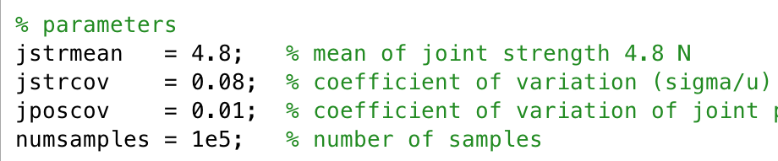
Provided
MATLAB code for 2D truss
Reads input file
Computes member forces
Writes output file
MATLAB code for Monte Carlo 2D truss
Defines MCS parameters
Reads input file
Perturb locations -> compute forces
Repeat
Creates Plots

